Slide 2
3D blade model updating by coupling HAWC2 and ABAQUS
Maria Luz Castilla Mena (s212601@dtu.dk)
Notes:
Hi, I am Maria and I am going to present my master thesis topic: Evolution of blade cracks with wind turbine simulation tolos (this is a provisional titile, it needs to be discussed)

Slide 3
INDEX
From last meeting
Progress of the project
For the next meeting

Slide 4
From last meeting
Search for a wind profile with the following characteristics:
Mean wind speed wsp = 30-40 m/s
Local gusts of around 60 m/s
Dynamic failure for isotropic materials ABAQUS

Slide 5


Progress of the project
Search for a wind profile with the following characteristics:
Mean wind speed wsp = 30-40 m/s
Local gusts of around 60 m/s ------ 49 m/s
Generate .bin turbulence files
Run HAWC2 to check Vy and moments
Time: 100 s
Time: 3600 s (whole simulation length)

Slide 6
Results

Slide 7
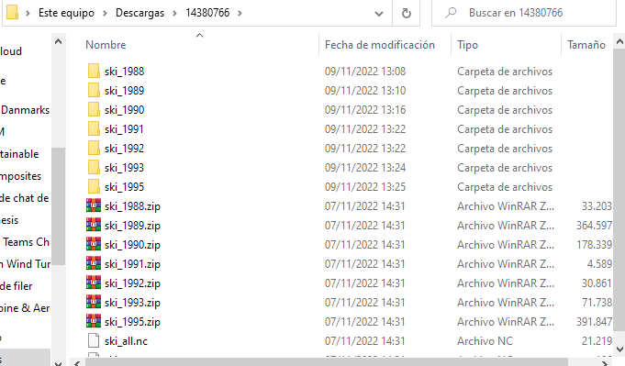
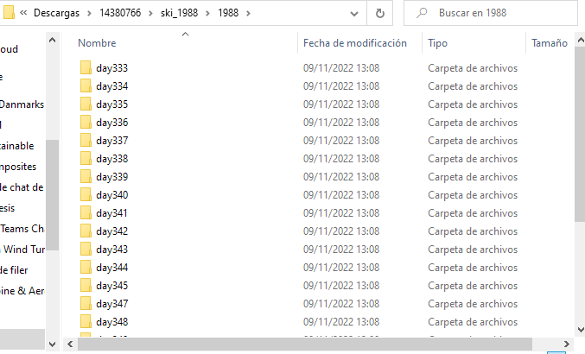
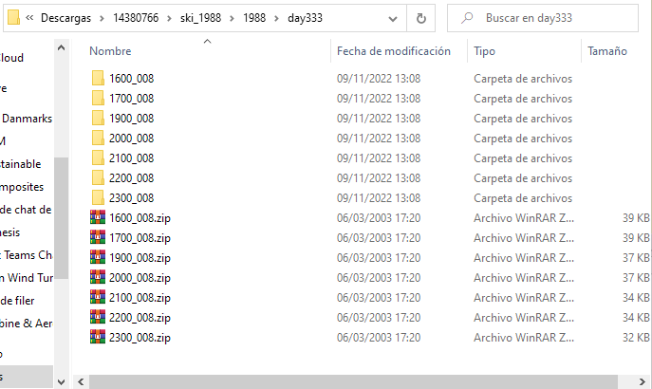
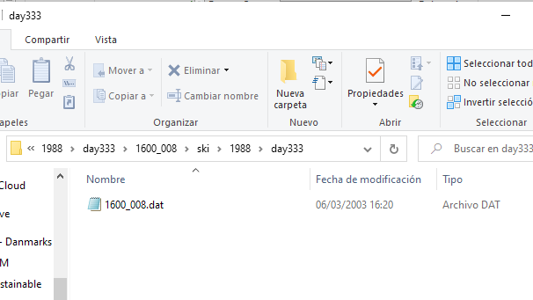
Search extreme wind profiles
Challenge: Lots of folders, lots of files!

Slide 8
Search extreme wind profiles
Location: Norway
Link: https://gitlab.windenergy.dtu.dk/fair-data/winddata-revamp/winddata-documentation/-/blob/master/ski.md
Wind profiles that meet the desired characteristics:
 | Desired characteristics | 2000_010.dat | 1700_010.dat
wsp | 30-40 m/s | 37.22 m/s | 34.55 m/s
Local gust | ~60 m/s | 47.3 m/s | 49.1 m/s

Slide 9
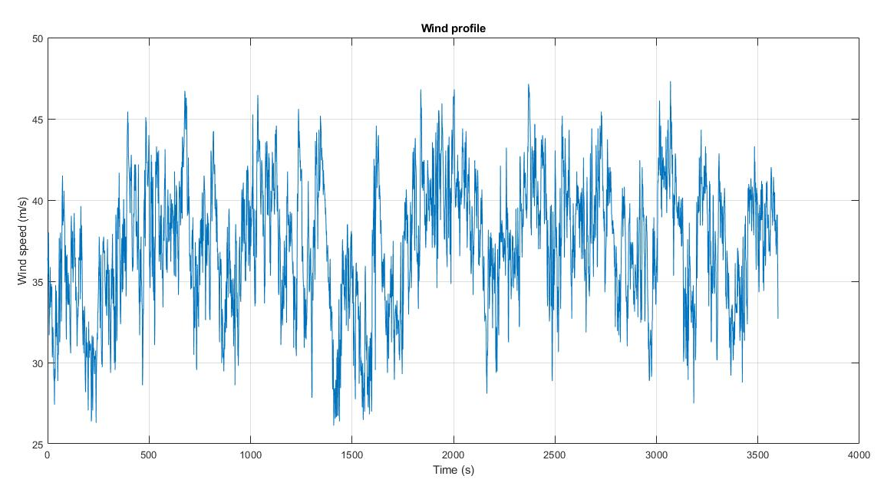
2000_010.dat

Slide 10
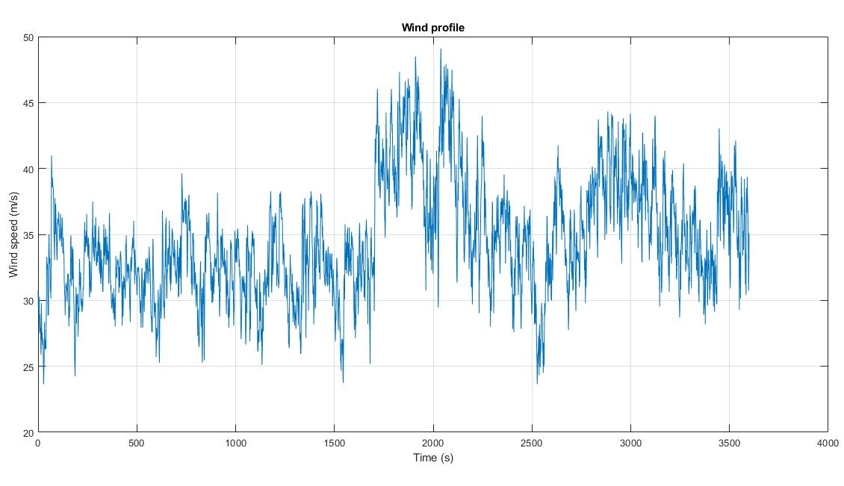
1700_010.dat

Slide 11
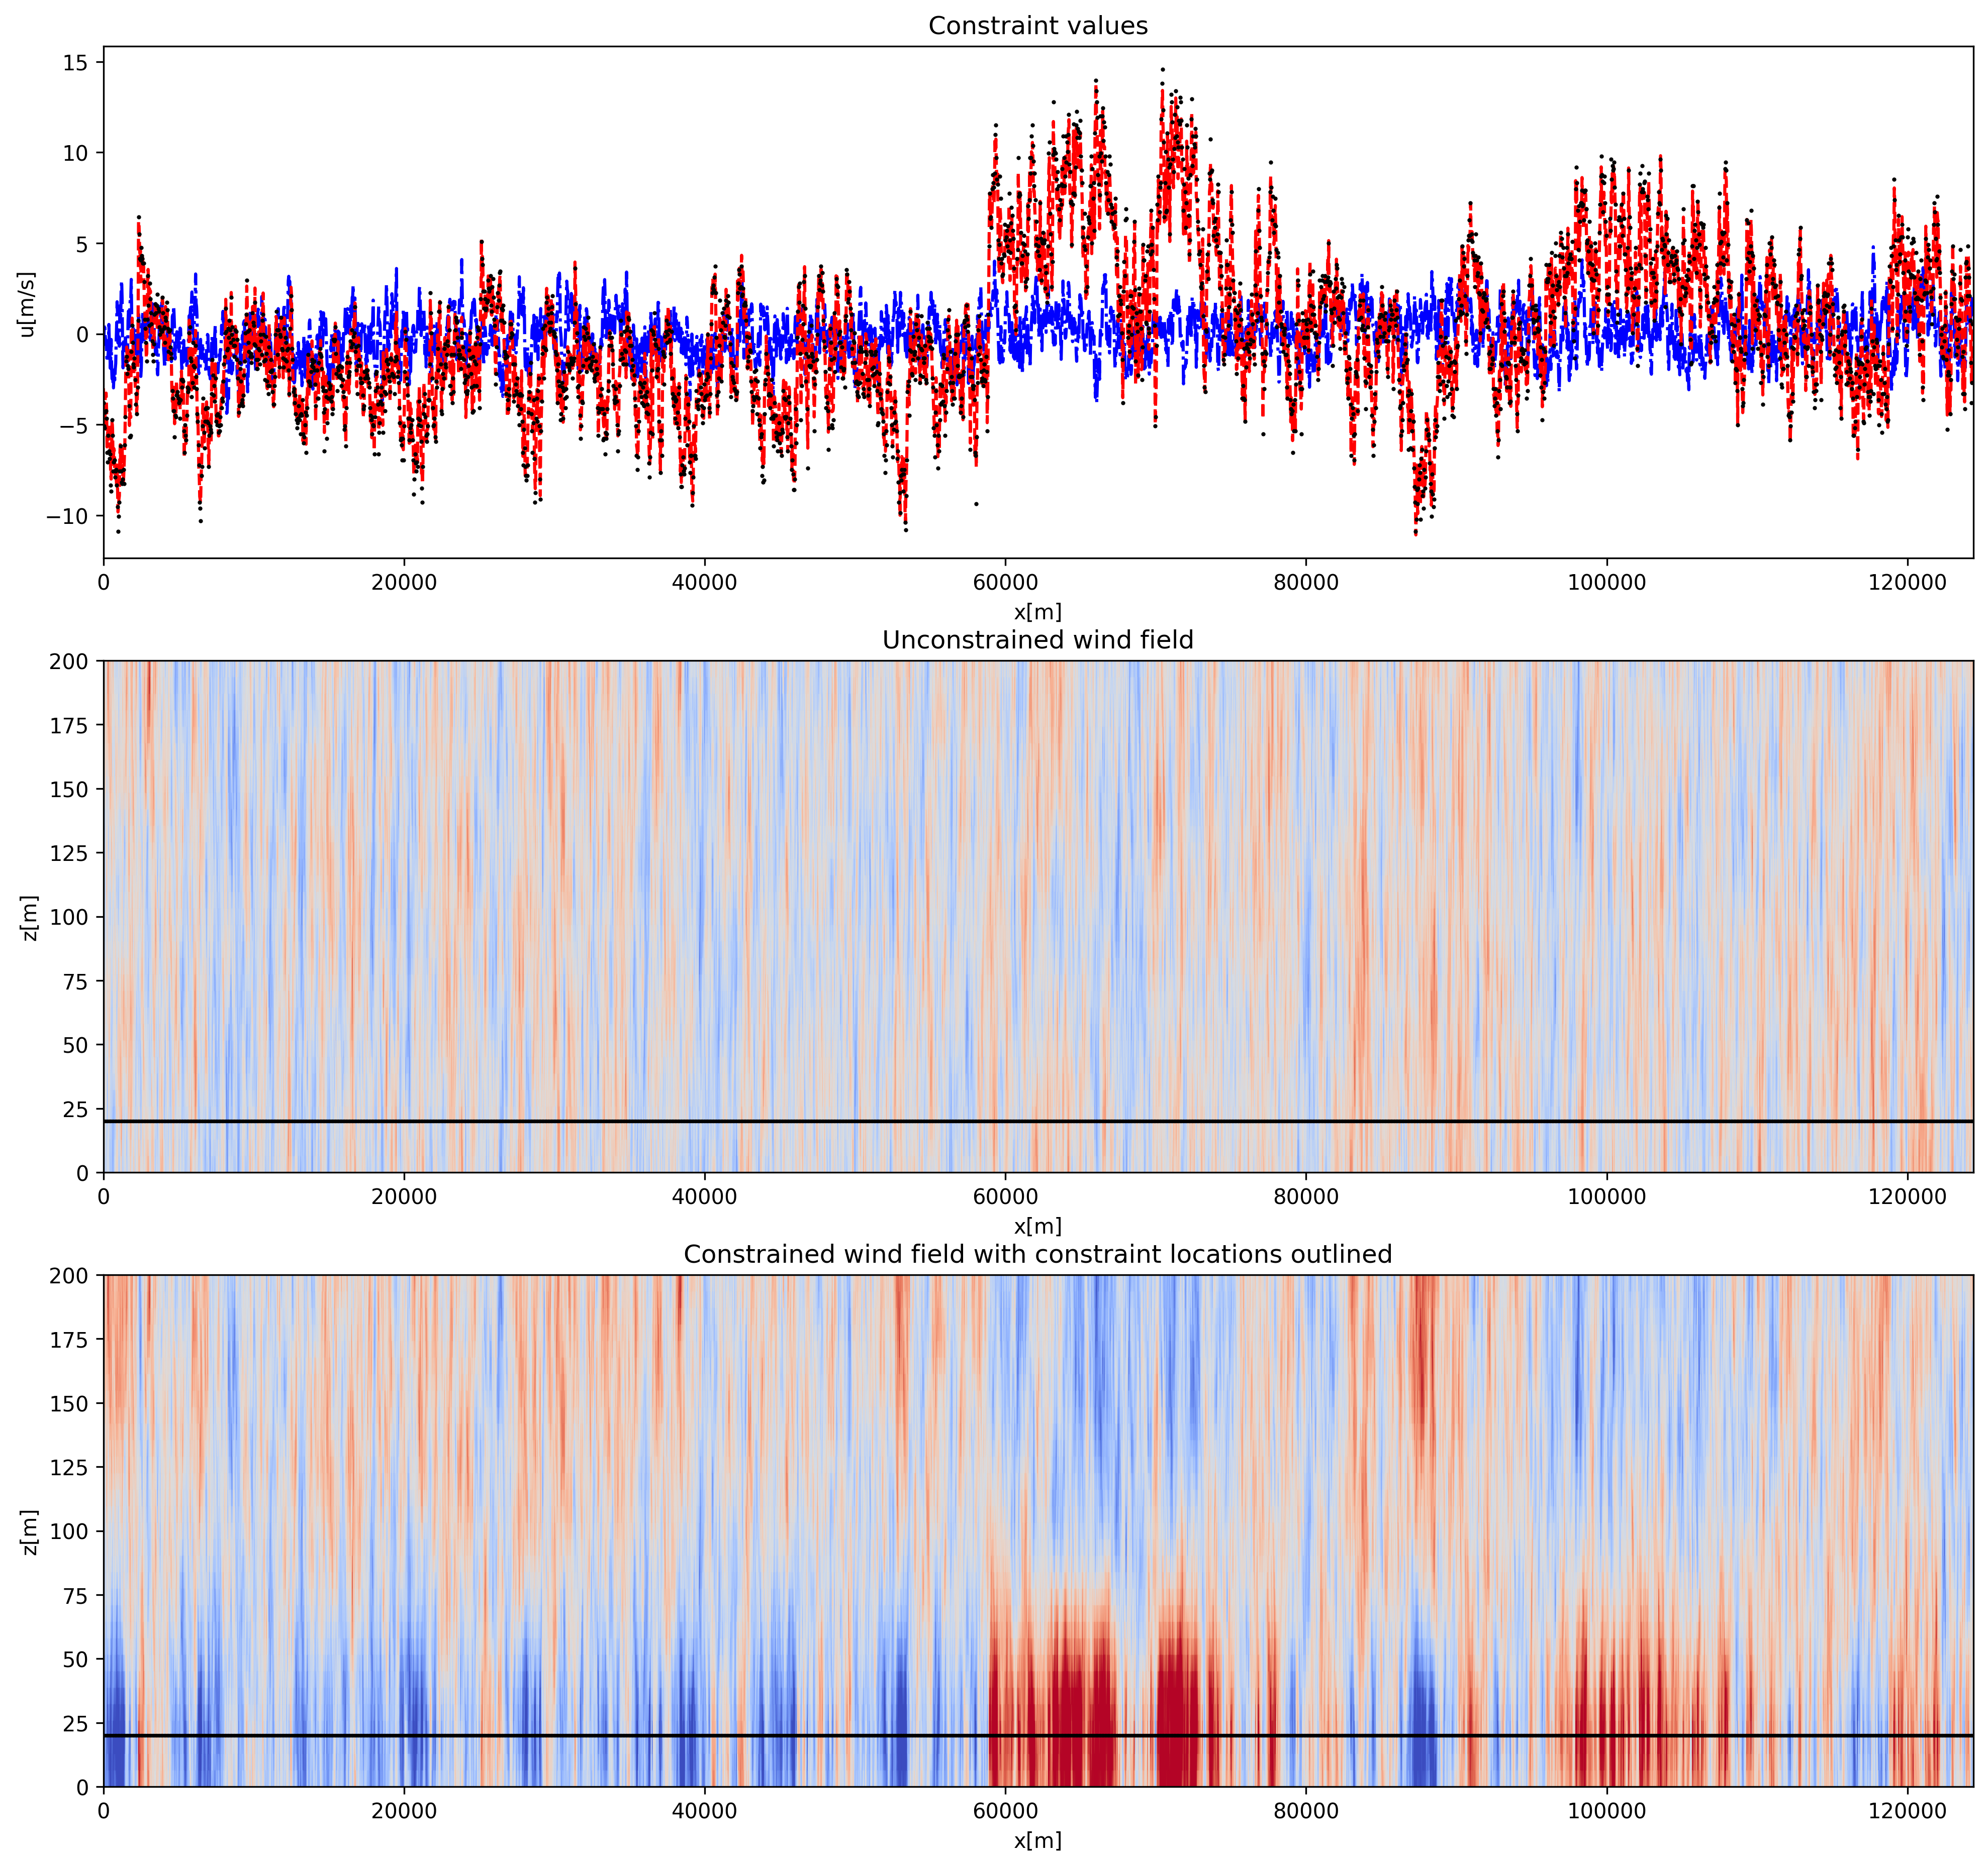
Generating turbulence files

Slide 12
Generating turbulence files

Slide 13
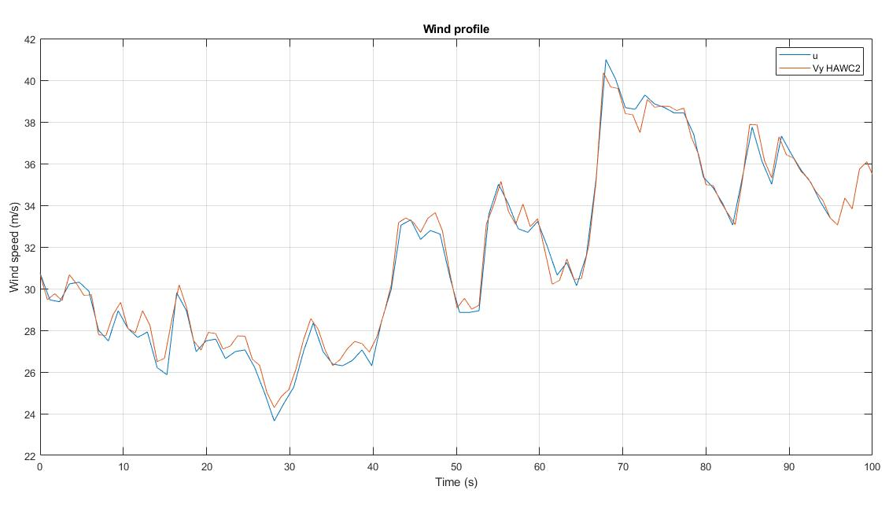
HAWC2 results: Time = 100 s

Slide 14
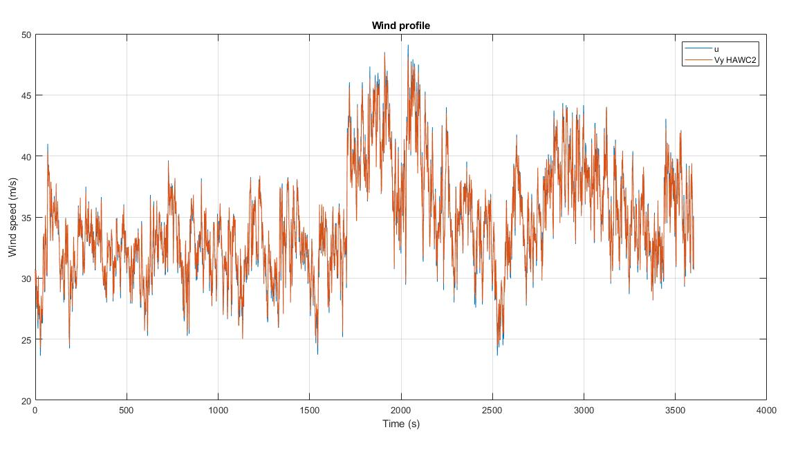
HAWC2 results: Time = 3600 s

Slide 15
Moments
Time (s) | Mean Mx (Nm) | Mean My (Nm) | Mean Mz (Nm)
100 | -2.0595e+05 | 3.2624e+05 | 2.2944e+03
3600 | 5.7456e+05 | 3.7031e+04 | -2.0290e+04

Slide 16
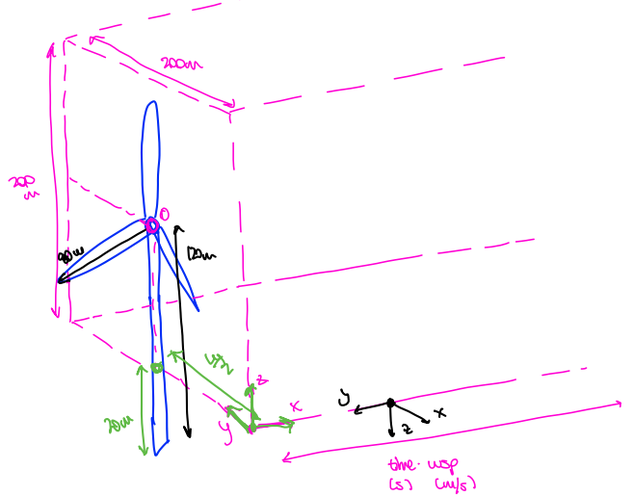
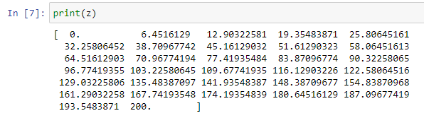
Turbulence Box

Slide 17
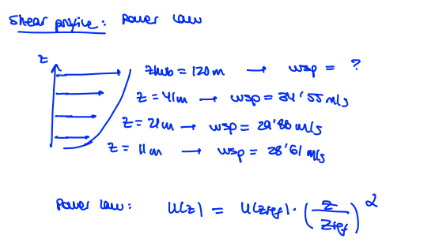
Turbulence Box
Where should I define the shear profile?
For 1700_010.dat:
Z (m) | u(z)
11 | 28.61 m/s
21 | 29.88 m/s
41 | 35.44 m/s
120 (zref) | ?
Alpha = 0.217
U(zref) = 43.617 m/s

Slide 18
For next meeting…

Slide 19
For the next meeting
More extreme wind profiles?
Turbulence box: Automate process
Dynamic failure for isotropic materials ABAQUS
Suggestions?

